Slide 1
Sigma002
Factor-based intraday trading strategy

Slide 2
Contents
Strategy & System features
Performance
Backtest vs Live trading P&L comparison
Risk & Rewards
Further developments
How to get connected

Slide 3
Strategy features
Long/short factor strategy
Long/short equal weighted strategy
Technical indicators only: Moving average, Momentum, Volatility etc
Top ranked selector
Only top N stocks are traded (even if signal picks up more stocks)
Intraday holding: each trade held for one day only
No borrowing cost / overnight charges
Avoid corporate actions / economic events
Risk adverse strategy
Not everyday is traded / strategy filters out unsuitable market conditions
Low trading costs / turnover

Slide 4
System features
Low latency
Trades get executed instantly <1s
Easy account setup and connection
Works like a “multi-socket plug adaptor”
Rapid pre-trade analysis
Live updating of trading signals and rapid trade decisions
Robustness

Slide 5

System diagram
Universe of Stocks
Market Capitalisation
Price Min / Max
ANNUAL REVIEW
M&A information
Liquidity / Trading Volume
Trading Pool of Selected Stocks
Volatility
Momentum
Relative Strength (LT/ST)
Moving Average
Historical Alpha (LT/ST)
MONTHLY REVIEW
Equal Weighted Portfolios

Slide 6
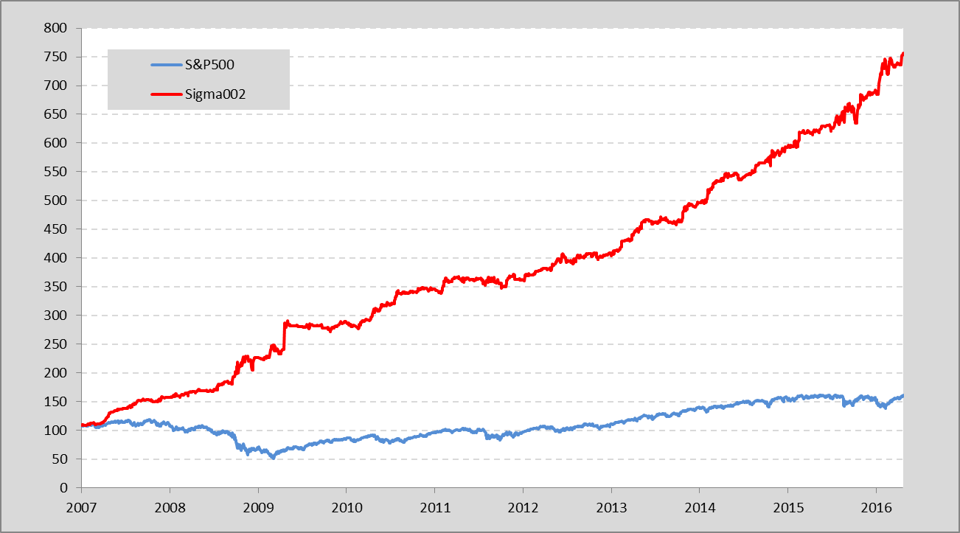
Performance
Sigma002 vs S&P500 from 2007 - Present

Slide 7
Performance
Sigma002 delivers consistent returns over past 10 years and significantly outperforms S&P500.
Annualised Return | Sigma002 | S&P500
Since Inception | 21.3% | 4.9%
Y2016 | 10.3% | 5.4%
Y2015 | 11.3% | -2.2%
Y2014 | 18.8% | 12.3%
Y2013 | 14.7% | 25.2%
Y2012 | 10.2% | 14.6%
Y2011 | 13.3% | 0.4%
Y2010 | 16.0% | 12.2%
Y2009 | 17.0% | 21.5%
Y2008 | 66.3% | -35.6%
Y2007 | 36.6% | 2.1%

Slide 8
Performance
Sigma002 has a significantly higher sharp ratio and lower maximum drawdown vs S&P500.
Sharpe Ratio: measures risk-adjusted return, the higher the better
Maximum Drawdown: maximum loss from peak portfolio value at any point in time
Sharp Ratio | Sigma002 | S&P500 | Difference
Since Inception | 1.9 | 0.3 | 1.6
Y2016 | 3.2 | 1.1 | 2.2
Y2015 | 1.2 | -0.1 | 1.3
Y2014 | 3.2 | 1.1 | 2.2
Y2013 | 2.8 | 2.1 | 0.7
Y2012 | 1.6 | 1.1 | 0.5
Y2011 | 1.3 | 0.1 | 1.2
Y2010 | 2.3 | 0.7 | 1.6
Y2009 | 1.2 | 0.9 | 0.4
Y2008 | 2.5 | -0.9 | 3.4
Y2007 | 3.9 | 0.2 | 3.7
Max. Drawdown | Sigma002 | S&P500 | Difference
Since Inception | 9.1% | 56.8% | -48%
Y2016 | 2.4% | 9.3% | -7%
Y2015 | 6.7% | 12.4% | -6%
Y2014 | 1.5% | 7.4% | -6%
Y2013 | 2.2% | 5.8% | -4%
Y2012 | 3.7% | 9.9% | -6%
Y2011 | 2.8% | 19.4% | -17%
Y2010 | 2.7% | 16.0% | -13%
Y2009 | 5.8% | 27.6% | -22%
Y2008 | 9.1% | 47.2% | -38%
Y2007 | 3.0% | 10.1% | -7%

Slide 9
Reliability of Backtest Results
Above backtested result not purely based on statistical simulation
Microstructure market conditions have been factored in i.e. three major factors accounted for:
Price slippage: Live trading price is not or never is the same price as obtained from historical data. This is so-called price slippage.
Opportunity costs: Simulation assumes that all trades are fully filled or executed. However, trades in live conditions are not always fully filled or executed due to market volume and volatility.
Ranked selection: In Sigma002, we trade top N stocks based on our trading rules. However, ranking stocks is imperfect in an intraday live market as trading signals might not be received simultaneously.

Slide 10
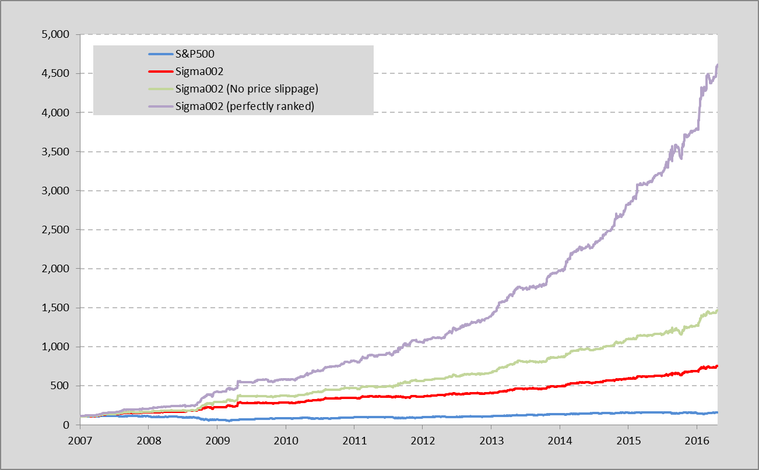
Reliability of Backtest Results
4592
Rank selection benefit
Sigma002
S&P500
1462
No Slippage
737
159

Slide 11
Reliability of Backtest Results
Empirical evidence states that the live trading strategy sharp ratio is generally 1.0 less than the simulation.
Sigma002 simulation results proves this observation.
Since Inception | Annualised Return | Sharp Ratio | Maximum Drawdown
Sigma002 (perfectly ranked) | 47.0% | 2.90 | 8.8%
Sigma002 (No price slippage) | 31.0% | 2.17 | 9.1%
Sigma002 | 21.3% | 1.93 | 9.1%

Slide 12
Sigma002 vs Monkey strategy
Sigma002 is not just because of luck.
2007
2008
2009
2010
2011
2012
2013
2014
2015
2016
Notes:
Chang timescale
Replot

Slide 13
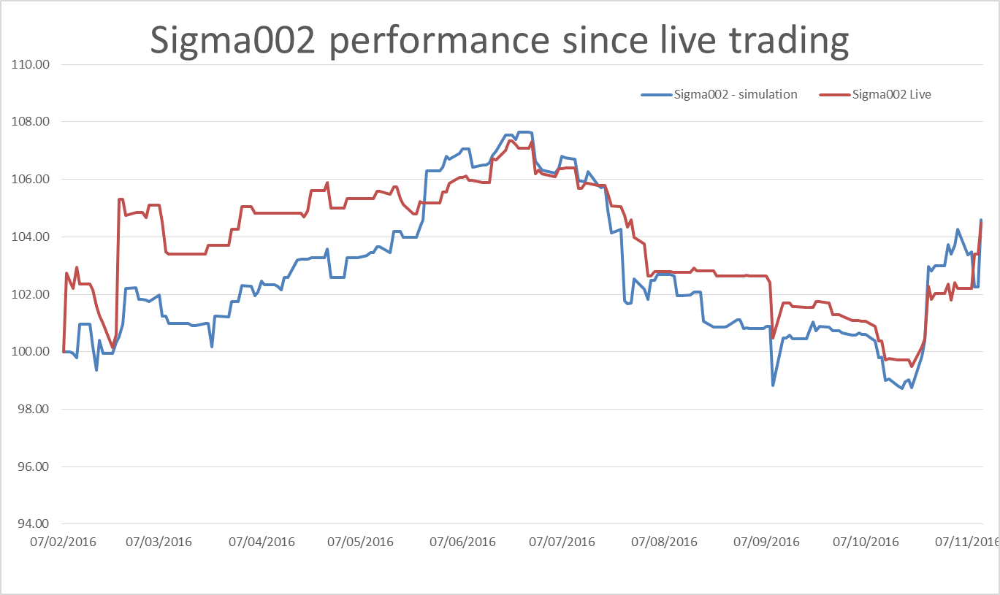
Live trading performance since Feb16

Slide 14
Recent traded stocks
Few number of traded stocks daily means:
More concentrated alphas
Lower trading costs
Date | Stock 1 | Stock 2 | Stock 3 | Stock 4 |  | Buy | BUY
20/04/2016 | CCE | HAS | TEL |  |  |  | SELL
21/04/2016 | EXPD | UA
22/04/2016 | ISRG | SLB
25/04/2016
26/04/2016
27/04/2016 | COF | TGNA | DPS
28/04/2016 | ABC | ALLE | BLL | BWA
29/04/2016 | CNC
02/05/2016
03/05/2016 | PNC | TMK
04/05/2016
05/05/2016
06/05/2016
Notes:
Less number of traded stock
Less trading cost
More concentrated alpha

Slide 15
Sigma002 under stressed condition

Slide 16
Question:
How much return can Sigma002 yield?
Answer: depends on your risk tolerance.
Scenario 1: you can bear loss suffered in 2008 Financial Crisis
Sigma002 | Annualised Return | Sharp Ratio | Maximum Drawdown
Since Inception | 21.3% | 1.93 | 9.1%
2016 Apr | 10.3% | 3.25 | 2.4%
Y2015 | 11.3% | 1.23 | 6.7%
Sigma002 | Annualised Return | Maximum Drawdown
Since Inception | 132.9% | 56.8%
2016 Apr | 64.3% | 15.0%
Y2015 | 70.6% | 42.0%
6.3X
S&P500 | Annualised Return | Sharp Ratio | Maximum Drawdown
Since Inception | 4.9% | 0.33 | 56.8%
2016 Apr | 5.4% | 1.10 | 9.3%
Y2015 | -2.2% | -0.07 | 12.4%

Slide 17
How much return can Sigma002 yield?
Scenario 2: I can only bear 25% loss in my cumulative investment.
Sigma002 | Annualised Return | Sharp Ratio | Maximum Drawdown
Since Inception | 21.3% | 1.93 | 9.1%
2016 Apr | 10.3% | 3.25 | 2.4%
Y2015 | 11.3% | 1.23 | 6.7%
Sigma002 | Annualised Return | Maximum Drawdown
Since Inception | 58.4% | 25.0%
2016 Apr | 28.3% | 6.6%
Y2015 | 31.1% | 18.5%
2.7X

Slide 18
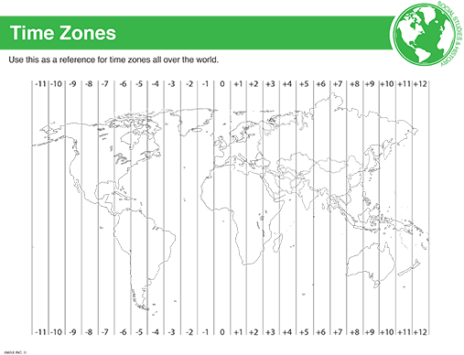
Further expansion to global markets
Money Never Sleeps
New York
London
Frankfurt, Paris
Hong Kong
Tokyo
Johannesburg
Syndey

Slide 19

Investment Platform
Our investment platform
Interactive Brokers is the largest U.S online brokerage firm
Global access to 24 countries’ equity markets
By far the broker which provides the lowest trading cost
Advanced IT framework with high execution and platform reliability
Transparent and comprehensive reporting
Provides detailed and sophisticated portfolio risk management
Account Type | Cash Account | Reg. T Margin Account | Portfolio Margin Account
Cash requirement | $ 10,000.00 | $25,000.00 | $100,000.00
Leverage | No leverage | Up to 4X | 4 ~ 8X

Slide 20

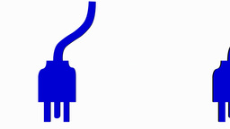
How to get connected
A few simple steps to let Sigma002 make money for you
Open an Interactive Brokers account
Set up a secondary account
(trading access only)
Tell us your account details and risk tolerance
Ready!
Sigma002

